Slide 1
Waterfall Charts
Marketing is the study and management of exchange relationships. Marketing is the business process of creating relationships with and satisfying customers.
Increase
To get your company’s name out there, you need to make sure.
Decrease
To get your company’s name out there, you need to make sure.
Total
To get your company’s name out there, you need to make sure.

Slide 2
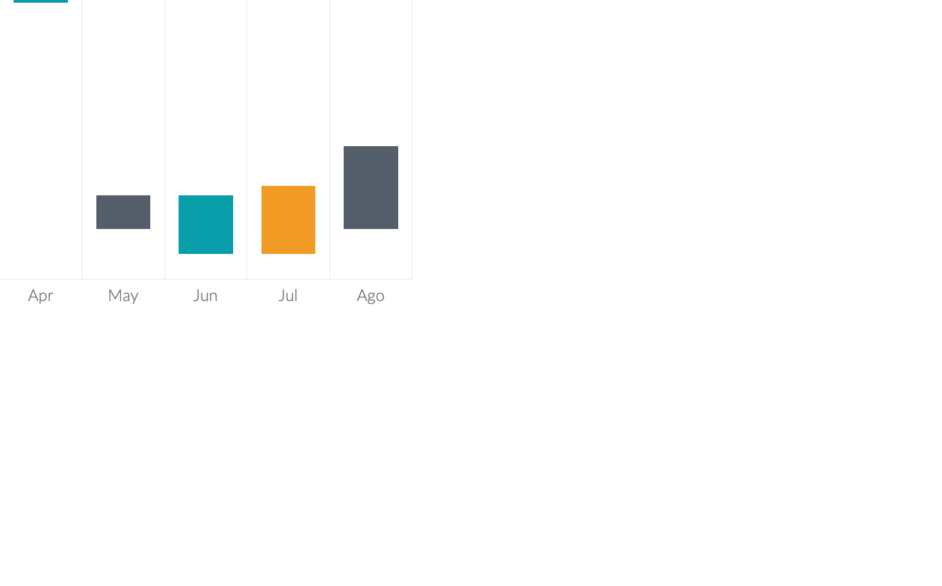
Waterfall Charts
Marketing is the study and management of exchange relationships. Marketing is the business process of creating relationships with and satisfying customers.
Increase
There are people who have a significant number of followers in every business domain on social media.
Decrease
There are people who have a significant number of followers in every business domain on social media.
Total
There are people who have a significant number of followers in every business domain on social media.

Slide 3
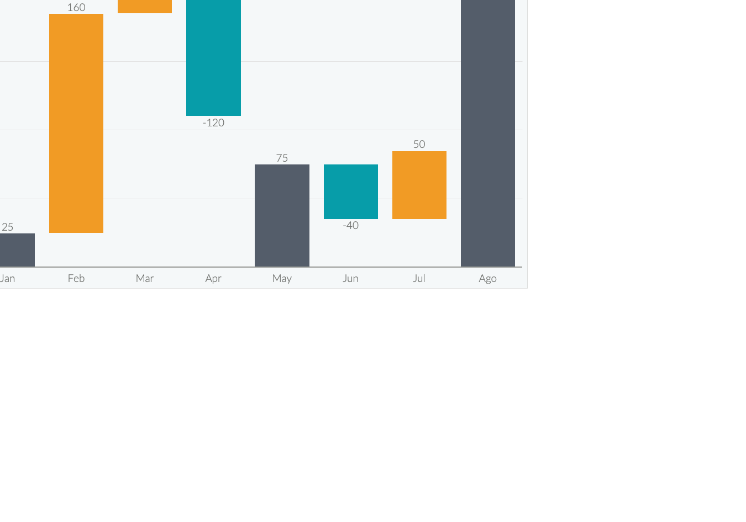
Waterfall Charts
Marketing is the study and management of exchange relationships. Marketing is the business process of creating relationships with and satisfying customers.
Increase
There are people who have a significant number of followers in every business.
Decrease
There are people who have a significant number of followers in every business.
Total
There are people who have a significant number of followers in every business.

Slide 4

Waterfall Charts
Marketing is the study and management of exchange relationships. Marketing is the business process of creating relationships with and satisfying customers.
Increase
Decrease
Total
To get your company’s name out there, you need to make sure.
To get your company’s name out there, you need to make sure.
To get your company’s name out there, you need to make sure.

Slide 5
Waterfall Charts
Marketing is the study and management of exchange relationships. Marketing is the business process of creating relationships with and satisfying customers.
Marketing
Desire
Awareness
There are people who have a significant number of followers in every business domain on social media.

Slide 6

Waterfall Charts
Marketing is the study and management of exchange relationships. Marketing is the business process of creating relationships with and satisfying customers.
To get your company’s name out there, you need to make sure.
To get your company’s name out there, you need to make sure.
To get your company’s name out there, you need to make sure.

